Slide 1














SAHARA INDIA PARIWAR
Presented By: Jenish, Kunj, Aryan, Jaydeep, Sarvam, Het, Yaksh, Aryamaan

Slide 2
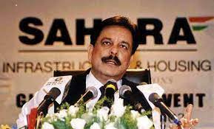
INTRODUCTION
The Sahara India Pariwar case revolves around allegations of illegal fundraising by the Sahara Group, led by Subrata Roy. Between 2008 and 2011, the company raised around ₹24,000 crore from millions of small investors through Optionally Fully Convertible Debentures (OFCDs) without regulatory approval from SEBI. The Securities and Exchange Board of India (SEBI) deemed these activities illegal, leading to a prolonged legal battle. In 2012, the Supreme Court ordered Sahara to return the funds to investors with interest.

Slide 3
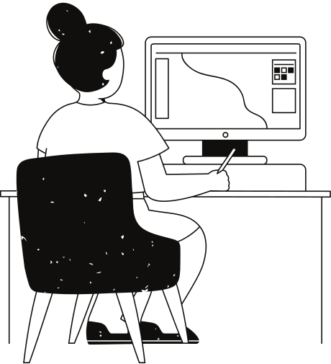
BACKGROUND
Background of Sahara India Pariwar: Sahara India Pariwar, founded by Subrata Roy in 1978, grew from a small business into a massive conglomerate with interests in various sectors such as real estate, media, financial services, hospitality, and entertainment. Its success was largely driven by collecting deposits from small investors in India, promising high returns. Sahara became a household name, known for its sponsorship of India’s cricket team, owning Air Sahara, and purchasing an IPL cricket team

Slide 4

CORE OF A SCAM
The Sahara scam centers on its method of raising funds through Optionally Fully Convertible Debentures (OFCDs). Between 2008 and 2011, two Sahara companies—Sahara India Real Estate Corporation (SIRECL) and Sahara Housing Investment Corporation (SHICL)—raised around ₹24,000 crore from millions of small investors without getting prior approval from the Securities and Exchange Board of India (SEBI)
These OFCDs were marketed as safe, high-return investment products but were later revealed to be illegal, as Sahara failed to comply with SEBI's regulations for public fundraising. SEBI stepped in to investigate the irregularities and found that Sahara had breached capital market rules by not adhering to disclosure and investor protection norms.

Slide 5
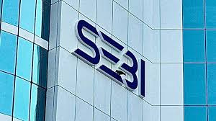
SEBI’S ROLE
In 2010, SEBI barred Sahara from raising any further capital through these schemes and ordered the company to return the funds raised from investors. However, Sahara resisted these orders, arguing that the capital was raised privately and was thus outside SEBI’s jurisdiction.
After several rounds of legal proceedings, the Supreme Court of India intervened in 2012, ordering Sahara to refund the investors' money with 15% interest. The court directed SEBI to oversee the repayment process​

Slide 6

Sahara’s Defiance and Subrata Roy’s Arrest
Sahara continued to defy the Supreme Court's orders, delaying the repayment and providing inconsistent or incomplete information about its investors. In February 2014, after multiple missed deadlines, the court ordered the arrest of Subrata Roy and other key Sahara officials. Roy was jailed in Tihar Prison for two years, released only on parole in 2016

Slide 7
Political and Social Aspects:
One of the reasons the Sahara case has dragged on is the alleged political influence that Subrata Roy enjoyed. Sahara had close connections with many influential political figures in India, which helped them delay and complicate legal actions against them​(Seven Pillars Institute) Sahara even published full-page newspaper ads to sway public opinion, claiming political persecution.

Slide 8
Current Status
As of 2021, Sahara still owes large sums of money to investors. Despite claims that it has refunded over ₹17,000 crore, SEBI has struggled to trace legitimate investors, leading to slow recovery efforts. Various Sahara cooperative societies continue to operate, but they remain under scrutiny by regulators and courts

Slide 9
Impact and Lessons
The Sahara scam exposed significant weaknesses in India's regulatory framework, particularly SEBI’s inability to take swift action due to political interference and legal loopholes. The case highlighted the need for better enforcement mechanisms, transparency in fundraising, and protection for small investors.
In essence, the Sahara case remains one of the largest and most complex corporate fraud cases in India, with financial, legal, and political implications still unfolding

Slide 10
thank
you

